Slide 1




Introduction to Next Generation Business Intelligence with Automated Analytics Mode in SAP Predictive Analytics
Michael Bliemel (Dalhousie University), Kristof Schneider (SAP SE)
March 2015

Slide 2
Introduction to Next Generation Business Intelligence with Automated Analytics Mode in SAP Predictive Analytics Agenda
Business Analytics in the Era of Big Data
Challenges for companies
Opportunities and benefits for companies
Introducing Predictive Analytics
How does Predictive Analytics fit in with other existing SAP Advanced Analytics Solutions?
Predictive Analytics – Hands On Tutorials

Slide 3
Introduction to Next Generation Business Intelligence with Automated Analytics Mode in SAP Predictive Analytics Agenda
Business Analytics in the Era of Big Data
Challenges for companies
Opportunities and benefits for companies
Introducing Predictive Analytics
How does Predictive Analytics fit in with other existing SAP Advanced Analytics Solutions?
Predictive Analytics – Hands On Tutorials

Slide 4

Introduction to Next Generation Business Intelligence with Automated Analytics Mode in SAP Predictive Analytics Business Analytics in the Era of Big Data
Business Analytics in the Era of Big Data
The pervasive digitization of all enterprises, corporate, commercial, and governmental, has resulted in the rise “big data” across all sectors (1,2)
Big data – defined as terabytes to exabytes of “fast moving information” (3,4) is the direct result of modern technologies’ ability to collect and store unprecedented amounts of digital information (1,5).
This information can be structured or unstructured (4), though it is the unstructured form of this data whose sheer “volume, velocity, and variety” has become an omnipresent function of the global economy (2,6)
1. Hou, C.-K. (December 01, 2012). Examining the effect of user satisfaction on system usage and individual performance with business intelligence systems: An empirical study of Taiwan's electronics industry. International Journal of Information Management, 32, 6, 560-573.
2. Chen, H., Chiang, R. H. L., & Storey, V. C. (January 01, 2012). Business Intelligence and Analytics: From Big Data to Big Impact. Management Information Systems Quarterly, 36, 4, 1165-1188.
3. Davenport, T. H. (December 01, 2013). Analytics 3.0. Harvard Business Review, 12(1).
4. Greenberg, P. (June 01, 2012). Big Data, Big Deal. CRM Magazine, 16, 6.
5. LaValle, S., Lesser, E., Shockley, R., Hopkins, M. S., & Kruschwitz, N. (January 01, 2011). Big Data, Analytics and the Path From Insights to Value. MIT Sloan Management Review, 52(2), 21-34.
6. McKinsey Global Institute. (December 01, 2011). Big data. McKinsey Quarterly, 4.

Slide 5
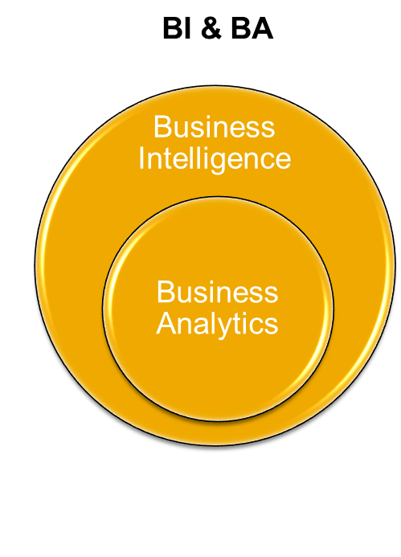
Introduction to Next Generation Business Intelligence with Automated Analytics Mode in SAP Predictive Analytics Business Analytics in the Era of Big Data
Business Intelligence & Business Analytics
Business intelligence (BI) describes concepts and methods to improve business decision-making by using fact-based support systems” (1)
Business analytics (BA), a component of BI, “provides the data Analytics techniques used to deliver value from decision support data” (2,3)
Business intelligence and business analytics are often used interchangeably (2,3), or together as the singular term “business intelligence & analytics” (BI&A) (1)
Both terms are traditionally employed by IS researchers to denote “IT platforms and tools used to gather, provide access to, and analyse data about an organization and its activities” (4)
1. Chen, H., Chiang, R. H. L., & Storey, V. C. (January 01, 2012). Business Intelligence and Analytics: From Big Data to Big Impact. Management Information Systems Quarterly, 36, 4, 1165-1188
2. Wixom, B., Ariyachandra, T., Goul, M., Gray, P., Kulkarni, U., & Phillips-Wren, G. (2011). The current state of business intelligence in academia. Communications of the Association for Information System, 29(16), 299-312.
3. Olsen, D. H., & Dupin-Bryant, P. A. (January 23, 2013). Combining business intelligence and stock market data: A primer for data analytics and business intelligence. Journal of Applied Business Research, 29, 1, 139-156.
4.. Glaser, J., & Stone, J. (January 01, 2008). Effective use of business intelligence. Healthcare Financial Management : Journal of the Healthcare Financial Management Association, 62(2), 68-72.

Slide 6
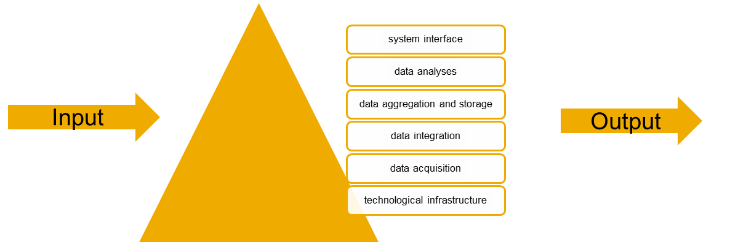
Introduction to Next Generation Business Intelligence with Automated Analytics Mode in SAP Predictive Analytics Business Analytics in the Era of Big Data
Business Intelligence & Analytics Platforms
BI&A platforms are often composed of sets of stacked information technologies, ordered from bottom to top to include(1,2)
The architectural structure of business intelligence centers around two distinct, yet interrelated, functionalities: getting data in and getting data out (3,4)
1. Glaser, J., & Stone, J. (January 01, 2008). Effective use of business intelligence. Healthcare Financial Management : Journal of the Healthcare Financial Management Association, 62(2), 68-72.
2. Lonnqvist, A., & Pirttimaki, V. (2006). The measurement of business intelligence. Information Systems Management, 23 (1), 32-40.
3. Wixom, B., Ariyachandra, T., Goul, M., Gray, P., Kulkarni, U., & Phillips-Wren, G. (2011). The current state of business intelligence in academia. Communications of the Association for Information System, 29(16), 299-312.
4. Popovič, A., Turk, T., & Jaklič, J. (January 01, 2010). Conceptual model of business value of business intelligence systems. Management, 15, 1, 5-29.

Slide 7
Introduction to Next Generation Business Intelligence with Automated Analytics Mode in SAP Predictive Analytics Agenda
Business Analytics in the Era of Big Data
Challenges for companies
Opportunities and benefits for companies
Introducing Predictive Analytics
How does Predictive Analytics fit in with other existing SAP Advanced Analytics Solutions?
Predictive Analytics – Hands On Tutorials

Slide 8

Introduction to Next Generation Business Intelligence with Automated Analytics Mode in SAP Predictive Analytics Challenges for companies
Challenges keeping up with data
When enterprises become flooded with information that cannot be handled efficiently, if at all, by conventional database management systems (1), they may suffer from “information overload,” finding it impossible to sift through this diverse and distinct data to determine its latent meaning (2)
While enterprises face these processing challenges, they are nonetheless fully cognizant of the potential competitive advantages locked within this data, since they can reveal market trends, customer preferences, and employee performance indicia, among other bits of highly valued information (3, 4)
1. Greenberg, P. (June 01, 2012). Big Data, Big Deal. CRM Magazine, 16, 6.
2. Chung, W., Chen, H., & Nunamaker, J. F., Jr. (2005). A Visual Framework for Knowledge Discovery on the Web: An empirical study of business intelligence exploration. Journal of Management Information Systems, 21(4), 57–84.
3. Cokins, G. (January 01, 2013). Driving Acceptance and Adoption of Business Analytics. Journal of Corporate Accounting & Finance, 24, 2, 69-74.
4. Kiron, D., & Shockley, R. (September 01, 2011). Creating business value with analytics. MIT Sloan Management Review, 53, 1, 57-63

Slide 9
Introduction to Next Generation Business Intelligence with Automated Analytics Mode in SAP Predictive Analytics Challenges for companies
Challenges keeping up with data
Seeking to avoid becoming “data rich and information poor” (1) in an era of uncertain economic times and increased global competitive pressure (2), enterprises across corporate cultures are increasingly dealing with, rather than discarding, big data by investing in advanced and uniquely tailored analytic technologies (3)
1. Popovič, A., Turk, T., & Jaklič, J. (January 01, 2010). Conceptual model of business value of business intelligence systems. Management, 15, 1, 5-29.
2. Griffin, Jane. (November 01, 2010). How Do I Make Deep Analytics Fit My Business?. Information Management 20(6).
3. Chen, H., Chiang, R. H. L., & Storey, V. C. (January 01, 2012). Business Intelligence and Analytics: From Big Data to Big Impact. Management Information Systems Quarterly, 36, 4, 1165-1188.

Slide 10
Introduction to Next Generation Business Intelligence with Automated Analytics Mode in SAP Predictive Analytics Challenges for companies
Challenges for Business Intelligence & Analytics
Effective implementation of BI&A platforms depends heavily on the professional skills of an enterprise’s workers (1,2,3)
“There is no such thing as business intelligence without the people to interpret the meaning and significance of information and to act on their knowledge gained” (1)
Employees must know what questions to ask, how to act upon the information presented, and when to communicate this information to domain experts within the organization (2,4).
1. Popovič, A., Turk, T., & Jaklič, J. (January 01, 2010). Conceptual model of business value of business intelligence systems. Management, 15, 1, 5-29.
2. Glaser, J., & Stone, J. (January 01, 2008). Effective use of business intelligence. Healthcare Financial Management : Journal of the Healthcare Financial Management Association, 62(2), 68-72.
3. Davenport, T. H. (December 01, 2013). Analytics 3.0. Harvard Business Review, 12(1).
4. Chen, H., Chiang, R. H. L., & Storey, V. C. (January 01, 2012). Business Intelligence and Analytics: From Big Data to Big Impact. Management Information Systems Quarterly, 36, 4, 1165-1188

Slide 11
Introduction to Next Generation Business Intelligence with Automated Analytics Mode in SAP Predictive Analytics Challenges for companies
Challenges for Business Intelligence & Analytics
Employees require a mix of technical and business knowledge that pairs strong information systems, and analytic software skills with occupational knowledge of the company’s business operations (2 ,3)
Critics feel that a significant constraint in exploiting the potential of BI&A is a shortage of talented employees (1,4,8)
“In the US alone a projected 1.5 million managers and analysts will lack the requisite skills to understand and make decisions based on the Analytics of vast amounts of data” (5)
1. Chen, H., Chiang, R. H. L., & Storey, V. C. (January 01, 2012). Business Intelligence and Analytics: From Big Data to Big Impact. Management Information Systems Quarterly, 36, 4, 1165-1188
2. Davenport, T. H. (2006). Competing on analytics. Harvard Business Review, 84(1), 98–107.
3. Shanks, G., Bekmamedova, N., & Willcocks, L. (July 01, 2013). Using Business Analytics for Strategic Alignment and Organisational Transformation. International Journal of Business Intelligence Research, 4 (3), 1-15.
4. Olsen, D. H., & Dupin-Bryant, P. A. (January 23, 2013). Combining business intelligence and stock market data: A primer for data analytics and business intelligence. Journal of Applied Business Research, 29, 1, 139-156.
5. Manyika, J., Chui, M., Brown, B., Bughin, J., Dobbs, R., Roxburgh, C., and Byers, A. H. 2011. “Big Data: The Next Frontier for Innovation, Competition, and Productivity,” McKinsey Global Institute

Slide 12
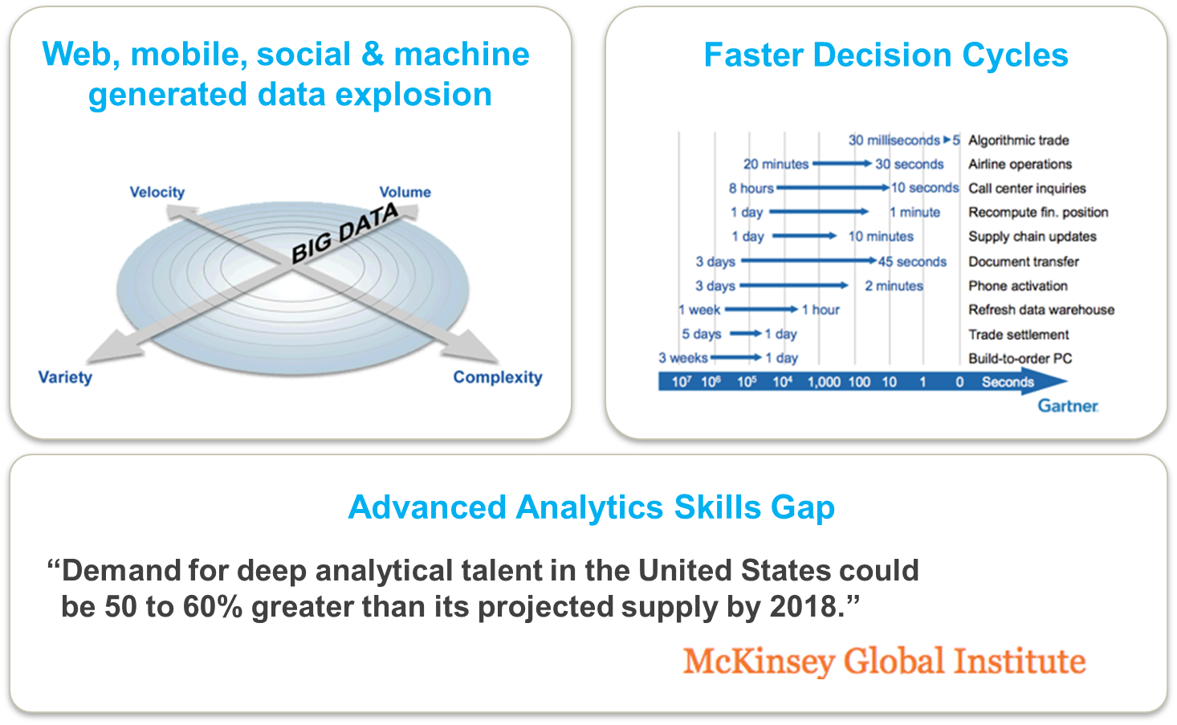
Introduction to Next Generation Business Intelligence with Automated Analytics Mode in SAP Predictive Analytics Challenges for companies
The Advanced Analytics Market is Ripe for Disruption

Slide 13
Introduction to Next Generation Business Intelligence with Automated Analytics Mode in SAP Predictive Analytics Agenda
Business Analytics in the Era of Big Data
Challenges for companies
Opportunities and benefits for companies
Introducing Predictive Analytics
How does Predictive Analytics fit in with other existing SAP Advanced Analytics Solutions?
Predictive Analytics – Hands On Tutorials

Slide 14
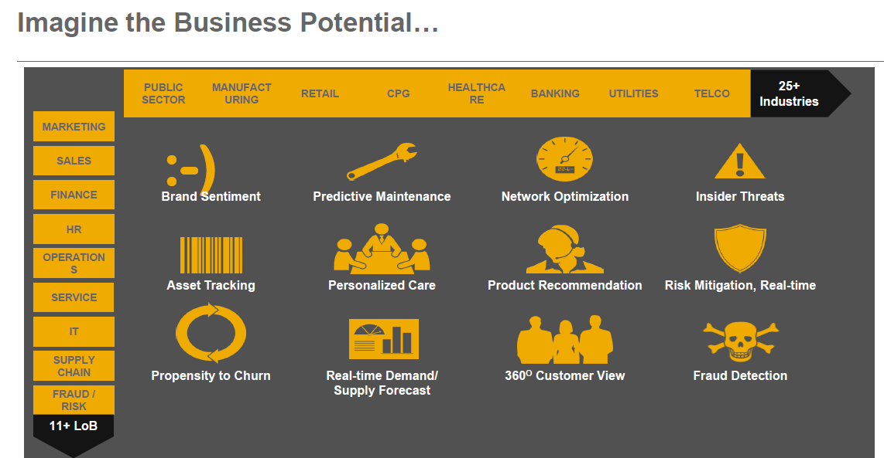
Introduction to Next Generation Business Intelligence with Automated Analytics Mode in SAP Predictive Analytics Opportunities and benefits for companies
The Impact of Analytics

Slide 15
Introduction to Next Generation Business Intelligence with Automated Analytics Mode in SAP Predictive Analytics Opportunities and benefits for companies
Benefits of Business Intelligence & Analytics
Frequently cited benefits of Business Intelligence and Analytics are:
Provide a factual, objective basis upon which enterprises can make speedy, fully informed decisions (1,2,3,4).
Separate useful information from the useless, cutting down on the information overload faced by enterprises (2,5)
Allow companies to better understand customers’ purchasing habits and predict their future needs, thereby introducing new products and services to fill any existent gaps (6)
Providing organizations a means to test hypotheses, discern trends, and forecast future avenues for exploration and exploitation (7)
1. Popovič, A., Turk, T., & Jaklič, J. (January 01, 2010). Conceptual model of business value of business intelligence systems. Management, 15, 1, 5-29.
2..Klatt, T., Schlaefke, M., & Moeller, K. (October 31, 2011). Integrating business analytics into strategic planning for better performance. Journal of Business Strategy, 32(6), 30-39.
3. Negash, S. (2004). Business intelligence. Communications of the Association for Information Systems, 13 (1), 177–195.
4. Shanks, G., Bekmamedova, N., & Willcocks, L. (July 01, 2013). Using Business Analytics for Strategic Alignment and Organisational Transformation. International Journal of Business Intelligence Research, 4 (3), 1-15.
5. Bouquet, C., Morrison, A., & Birkinshaw, J. (December 31, 2008). International attention and multinational enterprise performance. Journal of International Business Studies, 40(1), 108-131.
6. Elbashir, M. Z., Collier, P. A., & Davern, M. J. (2008a). Measuring the effects of business intelligence systems: The relationship between business process and organizational performance. International Journal of Accounting Information Systems, 9 (3), 135–153.
7. Cokins, G. (January 01, 2013). Driving Acceptance and Adoption of Business Analytics. Journal of Corporate Accounting and Finance, 24, 2, 69-74.

Slide 16
Introduction to Next Generation Business Intelligence with Automated Analytics Mode in SAP Predictive Analytics Opportunities and benefits for companies
Business is paying attention to Predictive Analytics!
Newsbyte: SAP Survey Finds Predictive Analytics Software No Longer in the Hands of Data Scientists
SAP NEWSBYTE — Dec. 4, 2013 — Nearly 90 percent of organizations agree that employing predictive analytic software has given them a competitive advantage, according to a new survey commissioned by SAP AG (NYSE: SAP). As part of its commitment to delivering solutions that address customers’ business needs, the company conducted research in association with LoudHouse, an independent research agency in both the United Kingdom and the United States and found that respondents see predictive analytics software as a key investment for their organizations.
More than 60 percent of those surveyed agree that predictive analytics is currently an investment priority for their organization, while almost 80 percent think predictive analytics will be a crucial investment within the next five years. And nearly 95 percent have seen an increase in the volume of data they are dealing with over the past year. This explosion of data puts pressure on businesses to make sense of it and predict future trends. Increasingly, businesses are looking for a way to bring predictive analytics to the masses and move its use beyond the realm of data scientists to business users. Other key findings of the survey include:
· Those who invested in predictive analytics say they are seeing return on investment quickly, with around 30 percent of respondents reporting a “major positive impact” from predictive analytics within the first six months and more than 50 percent indicating positive impact six to nine months after roll out
· Those using predictive analytics say it has had a positive impact on their organization with finance, sales and marketing and expect to benefit most from the use of predictive analytics in the future
· Businesses say they are using predictive analytics to exploit opportunities rather than minimize risk
· Predicting customer needs and market trends are seen as the most valuable scenarios for which to use predictive analytics
“Despite some of the skills and resource challenges, there is a real sense from the research that the emphasis on advanced predictive analytics has moved from minimizing risk to maximizing future growth potential in areas like next best activity for customer relationship management,” said James Fisher, vice president, Marketing, Analytics, SAP. “If businesses can put the right investment into developing a data-driven workforce, alongside data-driven decisions, processes and applications, they can accelerate their performance, reduce decision latency, unlock new global markets and uncover new revenue opportunities.”
To harness this growing market, customers will seek solutions that are user-friendly and easy-to-navigate. A leader in the business intelligence (BI) market, the portfolio of analytics solutions from SAP helps everyday business users to evaluate data and unearth actionable insight. With its recent acquisition of KXEN, SAP deepens this commitment with solutions to enhance the existing portfolio.

Slide 17
Introduction to Next Generation Business Intelligence with Automated Analytics Mode in SAP Predictive Analytics Opportunities and benefits for companies
Business is paying attention to Predictive Analytics!
Competitive Advantage from Predictive Analytics
90% agree that predictive analytics has given them a competitive advantage
60% agree that predictive analytics is currently an investment priority for their organization
80% think predictive analytics will be a crucial investment within the next five years.
Rise of Big Data
95% have seen an increase in the volume of data they are dealing with over the past year.
Quick ROI
Seeing return on investment quickly, with around 30% of respondents reporting a “major positive impact” from predictive analytics within the first six months and more than 50% indicating positive impact six to nine months after roll out
Customer Facing Apps benefit most
Those using predictive analytics say it has had a positive impact on their organization with finance, sales and marketing and expect to benefit most from the use of predictive analytics in the future
Predicting customer needs and market trends are seen as the most valuable
Full story about the LoudHouse survey is here:
http://www.news-sap.com/sap-survey-finds-predictive-analytics-software-no-longer-in-the-hands-of-data-scientists/

Slide 18
Introduction to Next Generation Business Intelligence with Automated Analytics Mode in SAP Predictive Analytics Agenda
Business Analytics in the Era of Big Data
Challenges for companies
Opportunities and benefits for companies
Introducing Predictive Analytics
How does Predictive Analytics fit in with other existing SAP Advanced Analytics Solutions?
Predictive Analytics – Hands On Tutorials

Slide 19

Introduction to Next Generation Business Intelligence with Automated Analytics Mode in SAP Predictive Analytics Introducing Predictive Analytics
Vodafone Netherlands Helps Customers Enjoy Their Mobile Life with Predictive Analytics
https://www.youtube.com/watch?v=fEQ6DEKOAOU#t=148

Slide 20
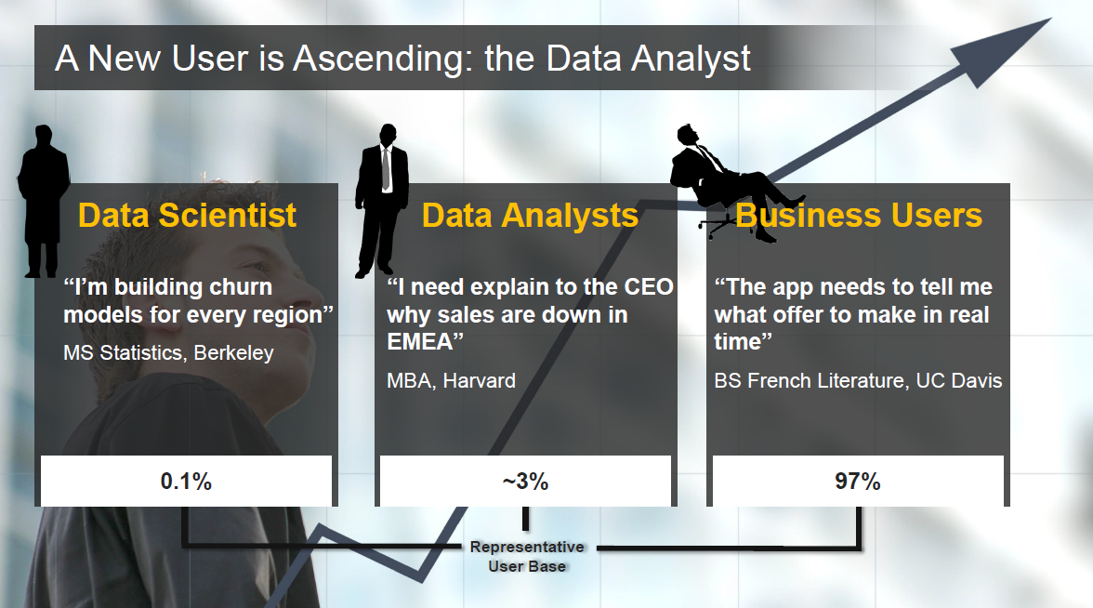
Introduction to Next Generation Business Intelligence with Automated Analytics Mode in SAP Predictive Analytics Introducing Predictive Analytics
Business Analytics User Personas

Slide 21
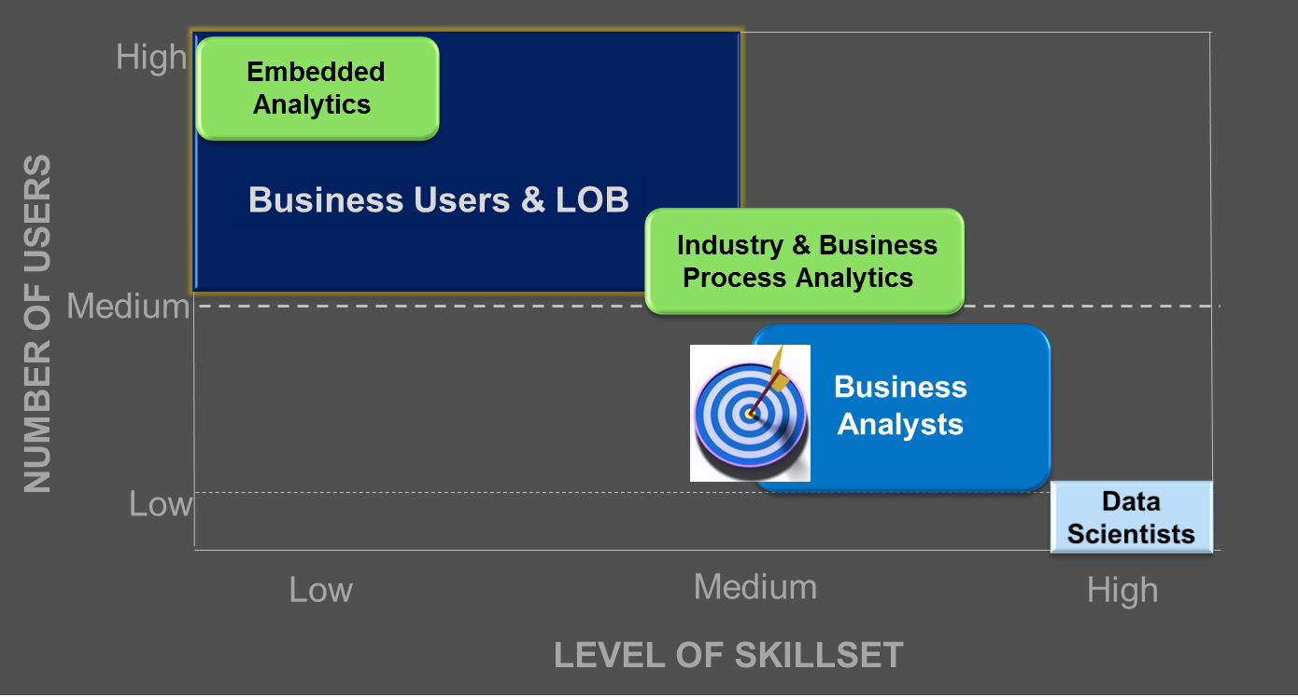
Introduction to Next Generation Business Intelligence with Automated Analytics Mode in SAP Predictive Analytics Introducing Predictive Analytics
Bringing Advanced Analytics to a Wider Audience

Slide 22
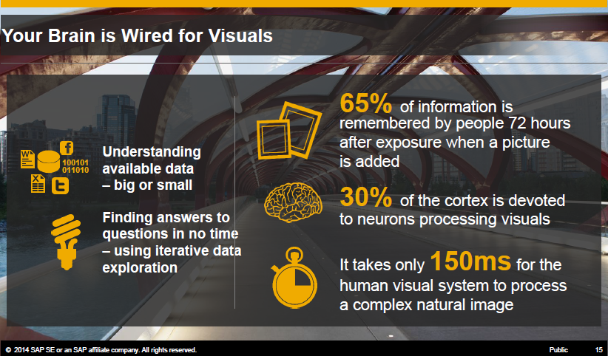
Introduction to Next Generation Business Intelligence with Automated Analytics Mode in SAP Predictive Analytics Introducing Predictive Analytics
Visual Analytics

Slide 23
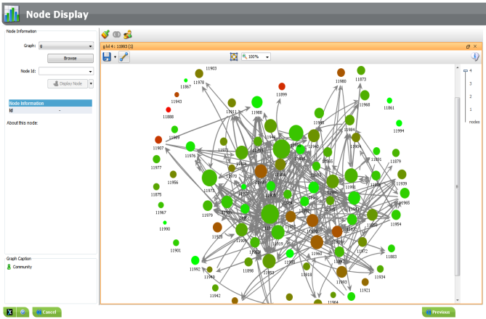
Introduction to Next Generation Business Intelligence with Automated Analytics Mode in SAP Predictive Analytics Introducing Predictive Analytics
Introducing Predictive Analytics (Automated Mode) – formerly InfiniteInsight
Predictive Analytics
formerly KXEN InfiniteInsight, joined SAP in 2013
uses very specific methods to address a set of well defined problems, often related to Specific Industries or Lines of Business.
In 2015 SAP Predictive Analysis and SAP InfiniteInsight solutions were combined to create SAP Predictive Analytics
Predictive Analytics (Automated Mode) consists of the following modules
Classification/Regression
Clustering
Time Series Analytics
Association Rules
Social Network Analytics
Recommender Models

Slide 24
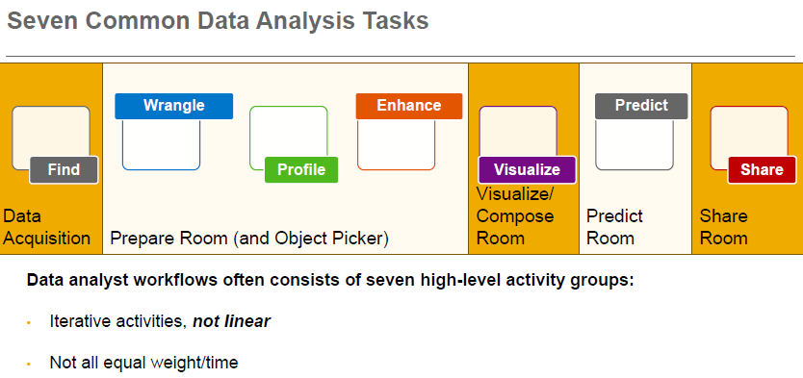
Introduction to Next Generation Business Intelligence with Automated Analytics Mode in SAP Predictive Analytics Introducing Predictive Analytics
Working with real business data

Slide 25
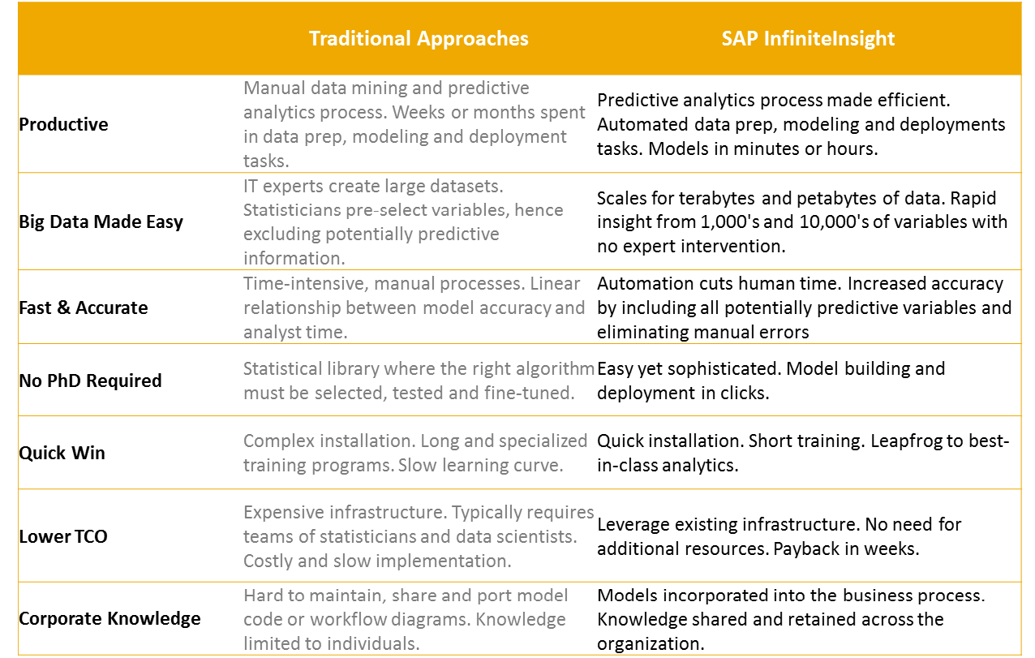
Introduction to Next Generation Business Intelligence with Automated Analytics Mode in SAP Predictive Analytics Introducing Predictive Analytics
Analytics Task Simplification
Automated Analytics Mode

Slide 26
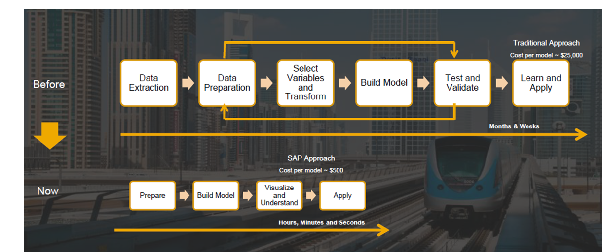
Introduction to Next Generation Business Intelligence with Automated Analytics Mode in SAP Predictive Analytics Introducing Predictive Analytics
Simplified Analytic Process
Faster Model Development Process with Predictive Analytics

Slide 27
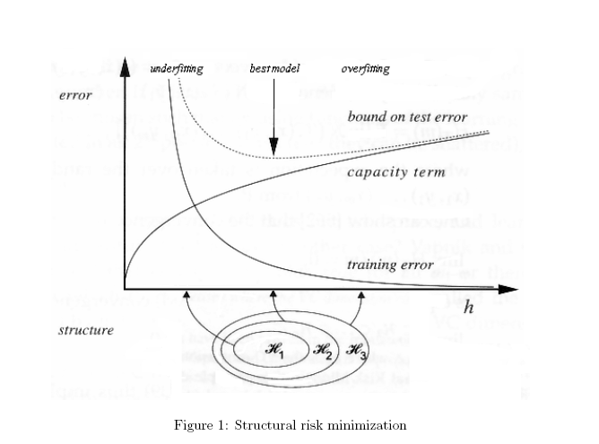
Introduction to Next Generation Business Intelligence with Automated Analytics Mode in SAP Predictive Analytics Introducing Predictive Analytics
Introducing Predictive Analytics as example for an Predictive & Advanced Analytics solution
Automated Mode Algorithms in SAP Predictive Analytics uses a modelling procedure based on Structural Risk Minimization, first proposed by Vapnik in 1974
Here a statistical earning procedure is used which selects a model that minimizes the upper bound on test error.
This has the result of accomplishing generalizability while avoiding over fitting a model on a training data set. In other words it deliberately trades off some predictive power to create models that are more robust and work for new data.
Vapnik, V.N., and A. Ya. Chervonenkis, 1974. Teoriya Raspoznavaniya Obrazov: Statisticheskie Problemy Obucheniya. (Russian) [Theory of Pattern Recognition: Statistical Problems of Learning]. Moscow: Nauka.

Slide 28
Introduction to Next Generation Business Intelligence with Automated Analytics Mode in SAP Predictive Analytics Agenda
Business Analytics in the Era of Big Data
Challenges for companies
Opportunities and benefits for companies
Introducing Predictive Analytics
How does Predictive Analytics fit in with other existing SAP Advanced Analytics Solutions?
Predictive Analytics – Hands On Tutorials

Slide 29
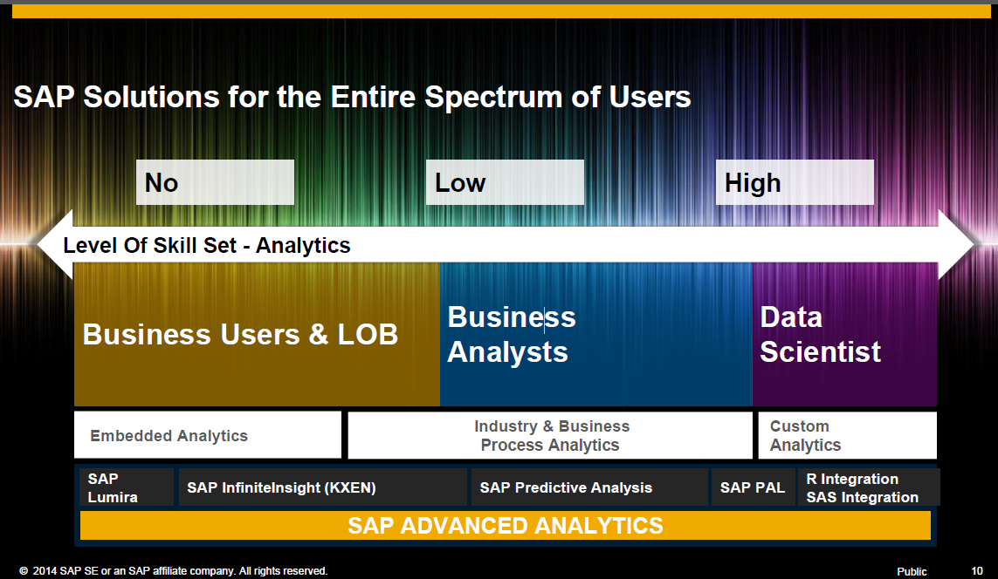
Introduction to Next Generation Business Intelligence with Automated Analytics Mode in SAP Predictive Analytics How does Predictive Analytics fit in with other existing SAP Advanced Analytics Solutions?
Different Tools for different Users

Slide 30
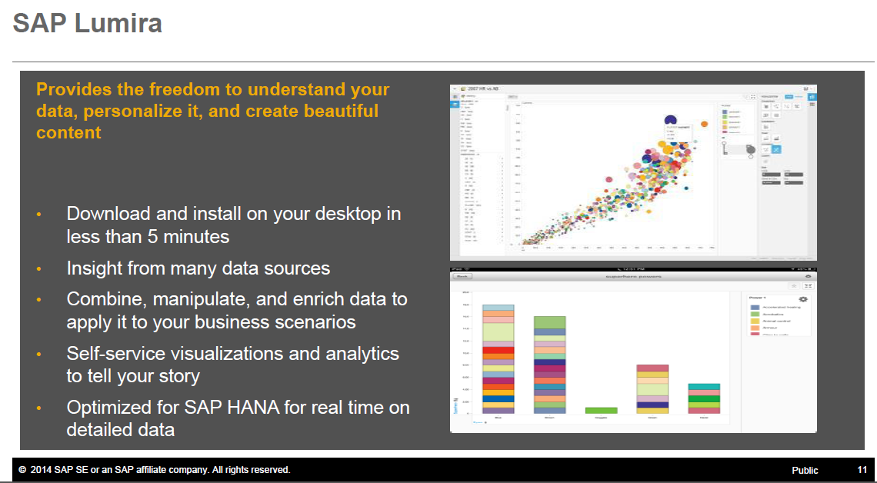
Introduction to Next Generation Business Intelligence with Automated Analytics Mode in SAP Predictive Analytics How does Predictive Analytics fit in with other existing SAP Advanced Analytics Solutions?
Tools for Data Visualization

Slide 31
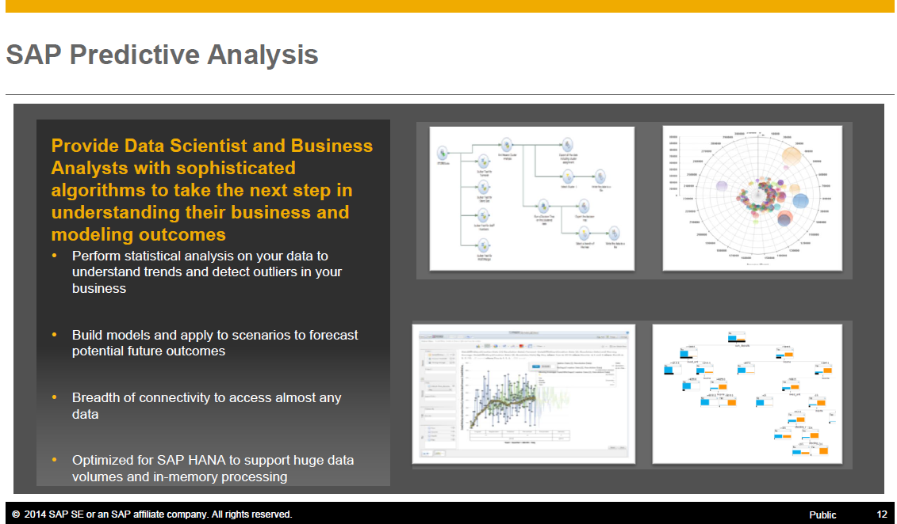
Introduction to Next Generation Business Intelligence with Automated Analytics Mode in SAP Predictive Analytics How does Predictive Analytics fit in with other existing SAP Advanced Analytics Solutions?
Tools for Prediction and Data Modelling
(Expert Mode in SAP Predictive Analytics)

Slide 32
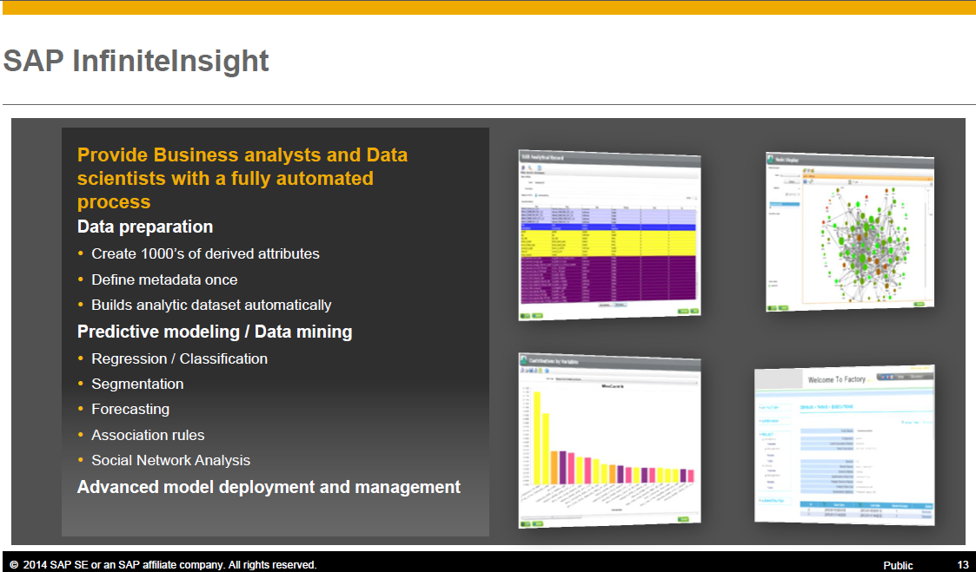
Introduction to Next Generation Business Intelligence with Automated Analytics Mode in SAP Predictive Analytics How does Predictive Analytics fit in with other existing SAP Advanced Analytics Solutions?
Next Generation Predictive Analytics
(Automated Mode in SAP Predictive Analytics)

Slide 33
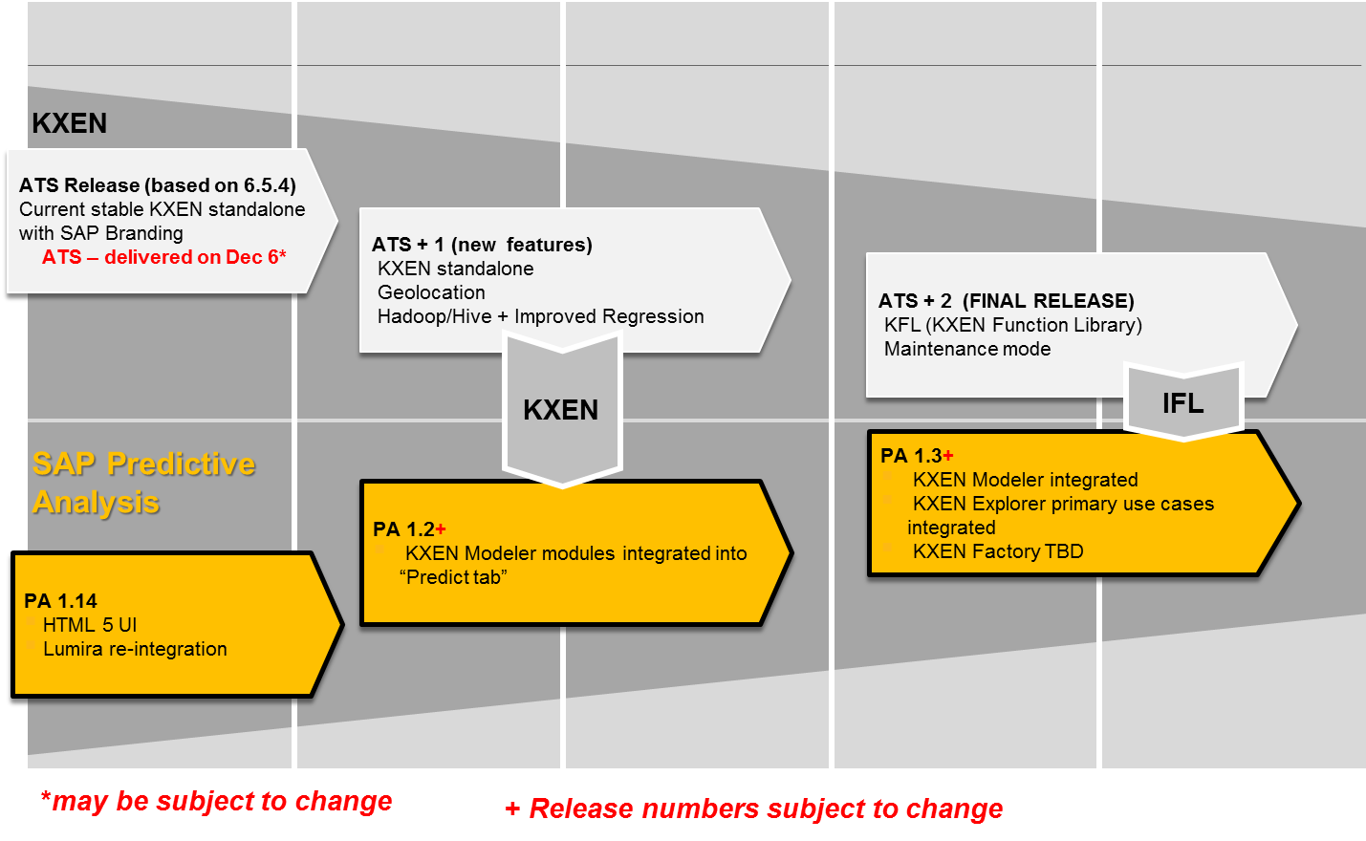
Introduction to Next Generation Business Intelligence with Automated Analytics Mode in SAP Predictive Analytics How does Predictive Analytics fit in with other existing SAP Advanced Analytics Solutions?
Predictive Analytics / KXEN Roadmap for a Unified Code Base

Slide 34
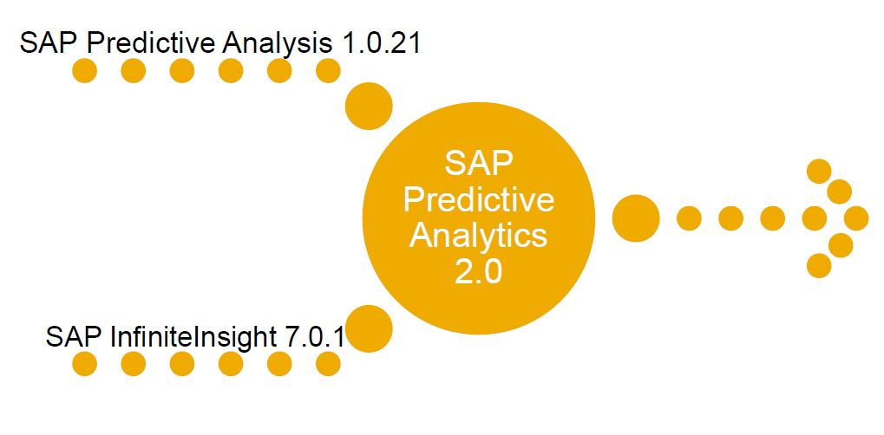
New name and product merging happened Feb. 11, 2015

Slide 35
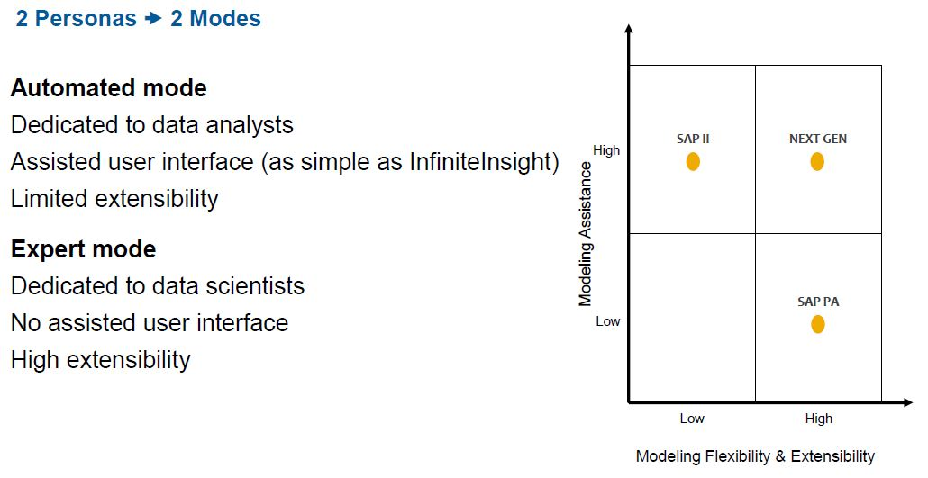
The Solution now has 2 modes using the II or PA platform

Slide 36
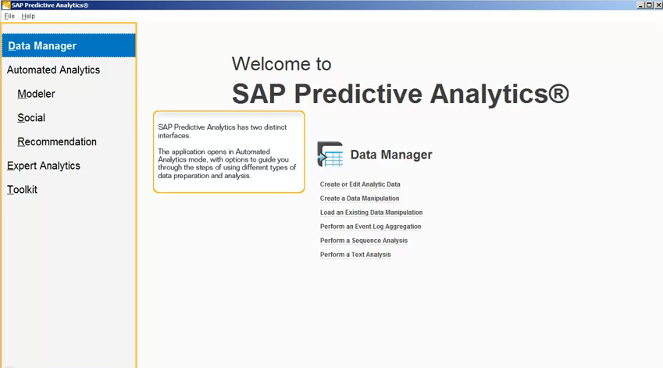
SAP Infinite Insight becomes SAP Predictive Analytics

Slide 37
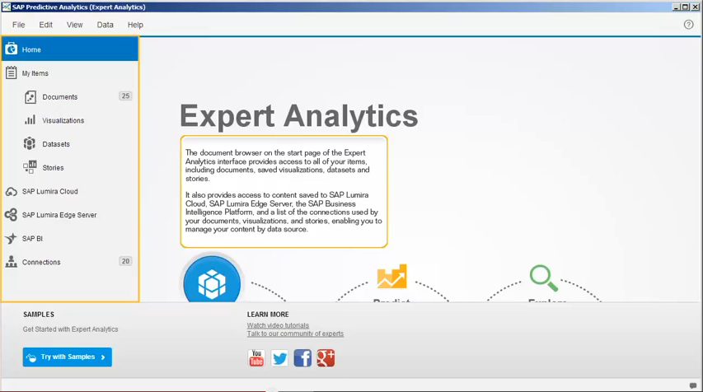
SAP PA becomes Expert Analytics in SAP Predictive Analytics

Slide 38
Introduction to Next Generation Business Intelligence with Automated Analytics Mode in SAP Predictive Analytics Agenda
Business Analytics in the Era of Big Data
Challenges for companies
Opportunities and benefits for companies
Introducing Predictive Analytics
How does Predictive Analytics fit in with other existing SAP Advanced Analytics Solutions?
Predictive Analytics – Hands On Tutorials

Slide 39
Hands On Exercises
The following four exercises will introduce you to the basics of how predictive modelling works in Predictive Analytics.

Slide 40
Exercise 1: Auto Insurance Risk Analytics with Automated Mode in SAP Predictive Analytics
In this exercise, an analyst of an Insurance company notices the number of accident claims has increased. He decides that it would be better to analyze the key factors that lead to claim and use them to evaluate the risk of claim for new contracts in the future. The analyst uses Predictive Analytics to statistically analyze what factors lead to a claim. Using the pattern developed using past data, she is able to predict the risk of claim for new contracts considering the profile of the subscriber and the car insured.

Slide 41
Exercise 2: Long-Term Customer Relationships with Automated Mode in SAP Predictive Analytics
In an ever-competitive market, banks face challenges to keep customers, especially when they are highly profitable. One of many KPIs regularly monitored in the retail bank is customer attrition. When a highly profitable customer leaves, it hurts the bottom line. Giving near real-time visibility to attrition helps executives to develop proactive strategies.
The head of sales for retail banking sees that the attrition numbers are rising. He is made aware of highvalue customers at risk of attrition through his dashboard and then can get a 360-degree view of the customer, including suggested offers to entice the customers to stay. A comprehensive customer view means finding insights that only come from a complete picture.
Mary, an analyst at BestRun Bank, has been tasked to find the factors that contributed to customer leave.

Slide 42
Exercise 3: Increasing Marketing Efficiency with Automated Mode in SAP Predictive Analytics
The Marketing department of a bank wants to analyse the success of their last Marketing campaign to increase the response rate of the next campaign. In order to make the most of our Marketing budget we want to be able to address only those customers that are most likely to respond positively. The bank carried out a marketing campaign by telephone to promote a term deposit. The dataset contains information about 45211 customers that were contacted and who purchased the product (who are noted in the set as the variable “y”).

Slide 43
Exercise 4: Social Recommendation with Automated Mode in SAP Predictive Analytics
This demo shows how we can consume transactional data to build links and communities between purchased products and consumers. We take these links of consumer behavior to build communities of products that are bought in a similar manner. After the patterns of product purchases are determined, we can score the results out into a database, offer them to a Complex Event Processing (CEP) service like NetWeaver or present them to a multichannel campaign management system like SAP Hybris. The product recommendations are based on the natural consumer behavior and product communities, therefore, the uptake of offers is higher than using other traditional Market Basket Analytics techniques like Association Rules.

Slide 44
Additional Resources
There is more to learn on your own. Follow these resources to get you started on becoming an expert user of Automated Mode in SAP Predictive Analytics.

Slide 45


Introduction to Next Generation Business Intelligence with Automated Analytics Mode in SAP Predictive Analytics Predictive Analytics – Hands On Tutorials
Predictive Analytics Interactive Demos– http://scn.sap.com/docs/DOC-32651
Predictive Analytics
Create a classification / regression model http://scn.sap.com/docs/DOC-60877
Create a time series Analytics http://scn.sap.com/docs/DOC-60878
Create a clustering model http://scn.sap.com/docs/DOC-60880
Create association rules http://scn.sap.com/docs/DOC-60901
Create a data manipulation http://scn.sap.com/docs/DOC-60876
Perform a text Analytics http://scn.sap.com/docs/DOC-60879
To report a technical issue with a tutorial, send an email to: BI_Suite_eLearning@sap.com.
Datasets for these hands on tutorials can all be found locally in
C:\Program Files\Predictive Analytics\InfiniteInsightV7.0.0\Samples
so it is easy to follow along with these demos.

Slide 46
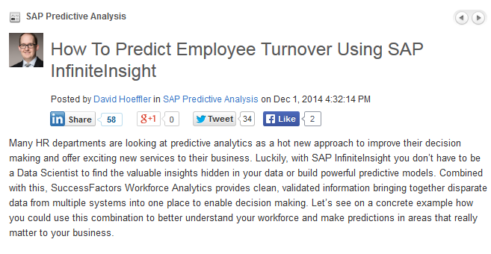
Introduction to Next Generation Business Intelligence with Automated Analytics Mode in SAP Predictive Analytics Demo
Predictive Analytics Demos and Resources
David Heffler has a nice Classification / Regression HR demo here: http://scn.sap.com/community/predictive-Analytics/blog/2014/12/01/how-to-predict-employee-turnover-using-sap-infiniteinsight

Slide 47
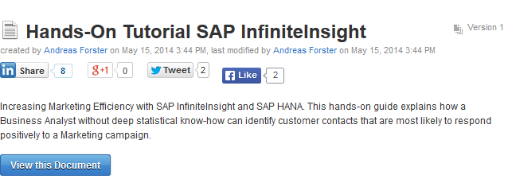
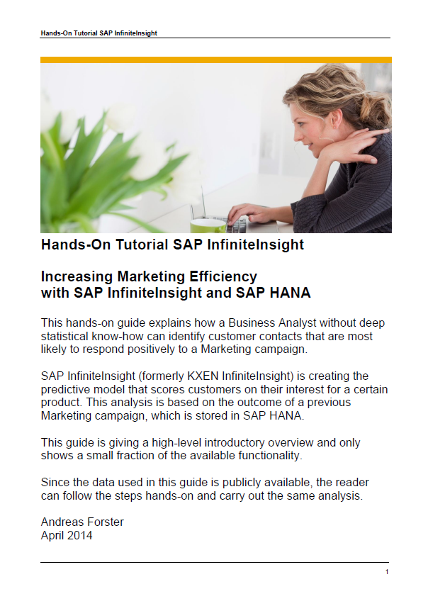
Introduction to Next Generation Business Intelligence with Automated Analytics Mode in SAP Predictive Analytics Demo
Predictive Analytics Demos and Resources
Andreas Forster has shared a Marketing problem hands on demo here: http://scn.sap.com/docs/DOC-55038

Slide 48
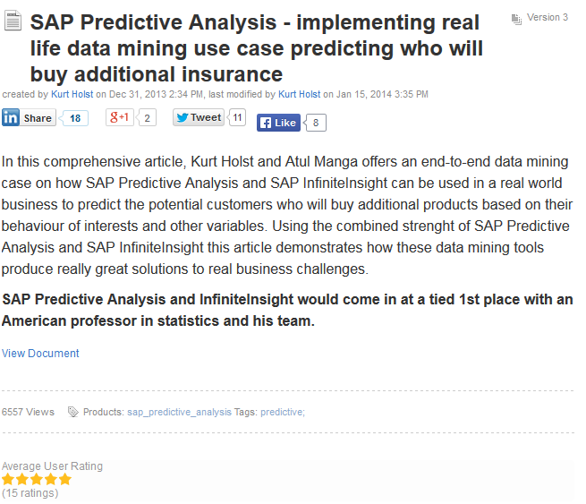
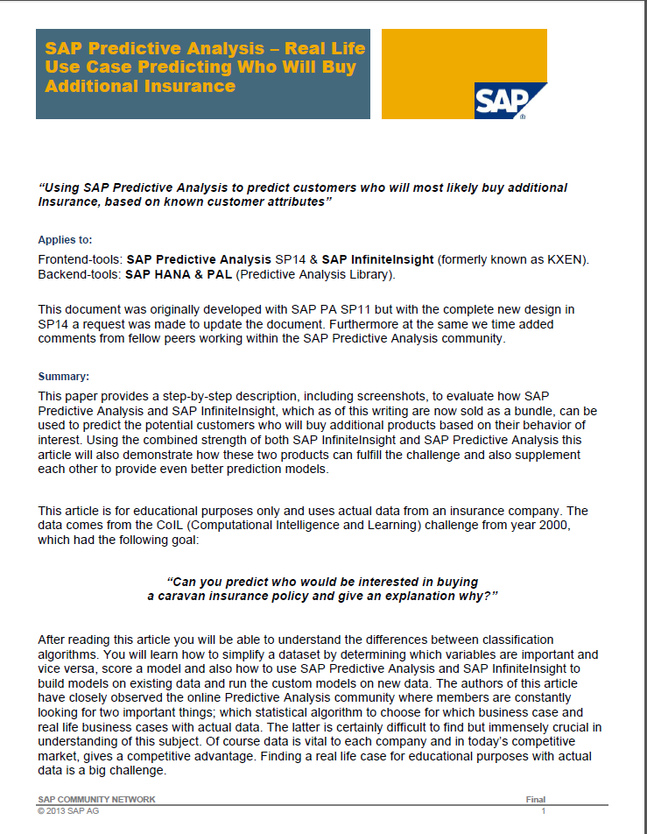
Introduction to Next Generation Business Intelligence with Automated Analytics Mode in SAP Predictive Analytics Demo
Predictive Analytics Demos and Resources
Kurt Holt and Atul Manga have shared a very descriptive 104 page document here that covers methods and tools with an example from in: http://scn.sap.com/docs/DOC-50803

Slide 49
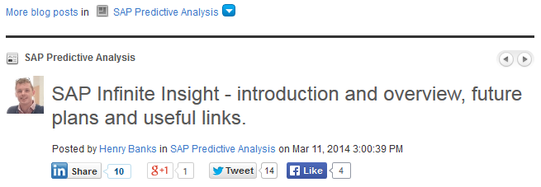
Introduction to Next Generation Business Intelligence with Automated Analytics Mode in SAP Predictive Analytics Demo
Predictive Analytics Demos and Resources
Henry Banks has a great introduction to InfiniteInsight here: http://scn.sap.com/community/predictive-Analytics/blog/2014/03/11/sap-infinite-insight--introduction-and-overview
Fantastic slides as well! (thanks Henry, we borrowed a few)

